Slide 1
MBO

Slide 2
Learning Outcome
Students will understand MBO.
Students will be able to apply MBO.

Slide 3
MCQ
Increasing sale by 15% is……..
Rule
Procedure
Method
Objective

Slide 4
MBO
The term Management by Objectives was coined by Peter Drucker in 1954.
The process of setting objectives in the organization to give a sense of direction to the employees is called as Management by Objectives.
It refers to the process of setting goals for the employees so that they know what they are supposed to do at the workplace.
Management by objectives guides the employees to deliver their level best and achieve the targets within the stipulated time frame.
Management by Objectives defines roles and responsibilities for the employees and help them chalk out their future course of action in the organization.

Slide 5
MBO
Objective standards outline what is fair, reasonable, or acceptable in an agreement.
The core concept of MBO is planning, which means that an organization and its members are not merely reacting to events and problems but are instead being proactive.
Think of an individual personal goal as one piece of a puzzle that must fit together with all of the other pieces to form the complete puzzle: the organizational goal.

Slide 6
The 5 step MBO process
Define organizational objectives:
As a project manager, your job may be to co-create company objectives or translate company objectives to your team in an understandable way.
2. Translate objectives to team members:
Use a top-down approach to translate the company objectives into individual goals for each team member.
3. Monitor performance :
As your team members work toward their specific objectives, you’ll need to monitor their performance.

Slide 7
Cont..
4. Evaluate progress:
You can evaluate team member progress by setting up performance appraisals.
5. Reward achievements:
The last step in the MBO system is rewarding the team for their achievements.

Slide 8
Pros of MBO
Increased team productivity: When team members have personal objectives, they have more clarity about why their work matters. As a result, their motivation and productivity increases.
Improved team communication: The MBO model can improve team communication and create a more open work environment because team members understand the objectives of the company and know that their personal goals align with those objectives.
Personalized team member objectives: Because the MBO system personalizes team member objectives and makes it a priority for team members to reach their highest potential, everyone in the company understands how their work makes an impact.

Slide 9
Cons of MBO
Prioritization of goal-setting over strategic planning: Companies that spend so much time setting goals may have less time to focus on company culture, operational issues, and other areas of involvement.
Increased strain on team members to meet goals: Because MBO focuses on the individual, team members may feel too much pressure to reach their goals.
Competition between team members: The extrinsic-focused reward system incorporated in MBO may promote competition between team members, which may get in the way of creating a healthy work environment.

Slide 10
MBO
Management by objectives example
For the digital marketers on the team, their personal objectives are to secure three new marketing clients for the quarter.
Managers monitor team member performance over the quarter to identify how each team member plans to achieve their personal goal and whether they’re making progress toward the goal.
If a team member reaches their goal at the end of the quarter, they are rewarded with a paid bonus.

Slide 11
MBE
Management by Exception

Slide 12
MBE
Management by Exception, shortly called as MBE is a management style or philosophy that empowers the manager to concentrate on the exceptionally important or critical matters and taking important decisions while facilitating the front line workers to complete the day to day activities.
It aims at keeping the focus of the management on extremely important tasks and problems or areas in need of action.
Management by exception is a practice in which managers only get notified when things are not going according to plan.
MBE is a practice where only significant deviations from a budget or plan are brought to the attention of management. These can be either operational or financial outcomes.

Slide 13
MBE
This model is similar to the vital signs monitoring systems in hospital critical care units. When one of the patient's vital signs goes outside the range programmed into the machine, an alarm sounds and staff runs to the rescue. If the machine is quiet, it's assumed that the patient is stable, and they will receive only regular staff attention.
It is a system of identification and communication that signals the manager as to when and where his attention is needed.
The main object of this system is to enable the manager to identify and isolate the problems that call for decision and action

Slide 14
Advantages of Management by Exception:
1. It saves time. Manager attends to real problems at a particular point of time.
2. Concentrated efforts are possible, as this system enables the manager to decide when and where he should pay his attention. It identifies crisis and critical problems.
3. Lesser number of decisions is required to be taken, which enables the manager to go into detail.
4. This enables to increase span of control and increase the activities for a manager.

Slide 15
Cont…
5. Use of past trends, history and available data can be made fully.
6. It alarms the management about the good opportunities as well as difficulties.
7. Qualitative and quantitative yardsticks are provided for judging the current position.
8. It prevents management from over managing.

Slide 16
Limitations of Management by Exception:
1. It requires a comprehensive observing and reporting system.
2. It increases paper work.
3. The system is silent till the problem becomes critical.
4. Some important factors, like human behaviour, are difficult to measure.

Slide 17
Process of Management By Exception
Identifying and describing Key Result Areas (KRA).
Establishing standards and determining an acceptable level of deviations.
Making Comparison of actual result with that of the expected or the standard result.
Ascertaining variance.

Slide 18
Process of Management By Exception (Cont…)
Analysing the causes of such variance (deviation).
Strategizing and taking necessary actions wherever required and possible.

Slide 19
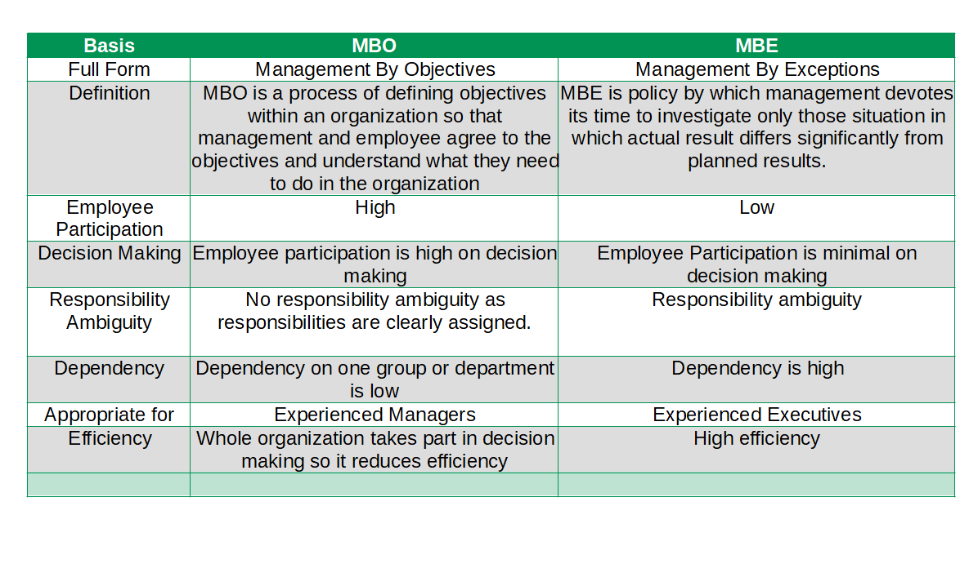

Slide 20
MCQ
Process of Management By Exception includes
Identifying Key Result Areas (KRA).
Establishing standards .
Making Comparison of results.
All of the above

Slide 21
Thank You

